Slide 1

Developing Intelligent Voicebots: A Comprehensive Guide Using Streamlit and OpenAI
By Khushal singh(MST03- 0078)

Slide 2
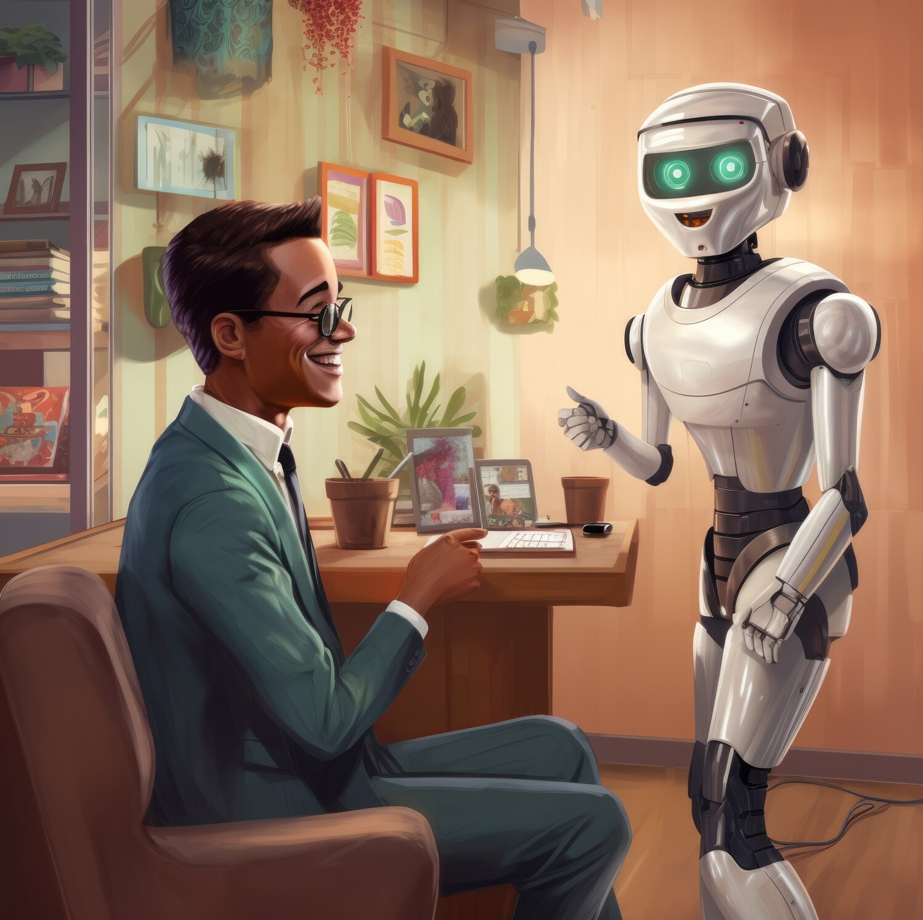


INTRODUCTION TO VOICEBOTS
are automated systems that utilize
to interact with users. This presentation will guide you through
the process of developing intelligent voicebots using and technologies. We aim to provide a
comprehensive understanding of the tools and methodologies involved.

Slide 3




UNDERSTANDING VOICEBOT ARCHITECTURE
A voicebot's architecture consists of several key components: ,
, and
. Each component plays a crucial role in ensuring eﬀective communication between the user and the bot, facilitating a seamless interaction experience.

Slide 4
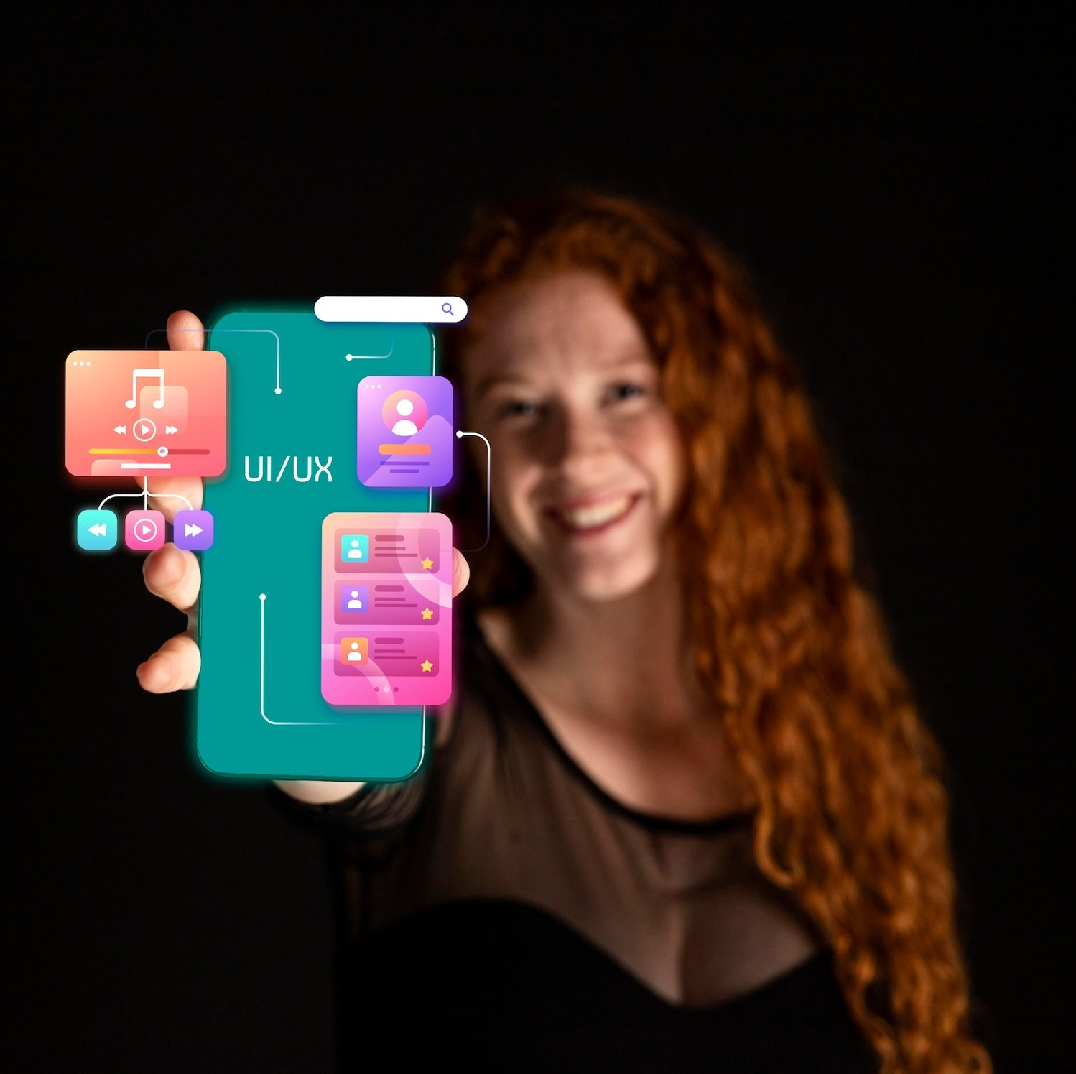

INTRODUCTION TO STREAMLIT
is an open-source framework that simplifies the creation of web applications for data science projects. It allows developers to build interactive interfaces with minimal coding, making it an ideal choice for deploying voicebot applications quickly and effciently.

Slide 5


LEVERAGING OPENAI'S API
OpenAI's API provides powerful tools for
and
By integrating this API, developers can
.
enhance their voicebots' capabilities, allowing them to understand complex queries and respond intelligently, thereby improving user satisfaction.

Slide 6


BUILDING A SIMPLE VOICEBOT
To build a simple voicebot, start by setting up
your the
environment and integrating
. This involves creating input
fields for user queries and output areas for displaying responses, ensuring a user-friendly experience while maintaining functionality.

Slide 7

TESTING AND ITERATION
Once your voicebot is built, thorough is essential. Collect user feedback and analyze interactions to identify areas for improvement. Iterating on your design and functionality will lead to a more robust and eﬀective voicebot that meets user needs.

Slide 8




DEPLOYMENT STRATEGIES
Deploying your voicebot can be achieved through various platforms such as
or local servers. Consider factors
such as , , and
to ensure that your voicebot performs optimally in a live environment.

Slide 9

CONCLUSION AND FUTURE DIRECTIONS
In conclusion, developing intelligent voicebots using and can significantly enhance user interaction. As technology
evolves, staying updated with the latest advancements will be crucial
for creating even more sophisticated voicebots in the future.

Slide 10
Thanks! references :
https://platform.openai.com/docs/g uides/text-to-
speechhttps://www.cybrosys.com/bl og/how-to-create-a-voice-chatbot-
using-openai-s-api

